Slide 1

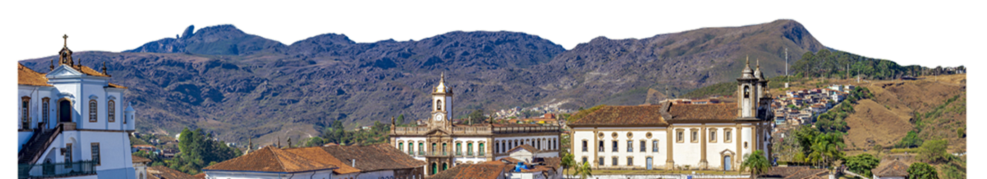
MineraMundi: International research network on mining, sustainability and social development

Slide 2
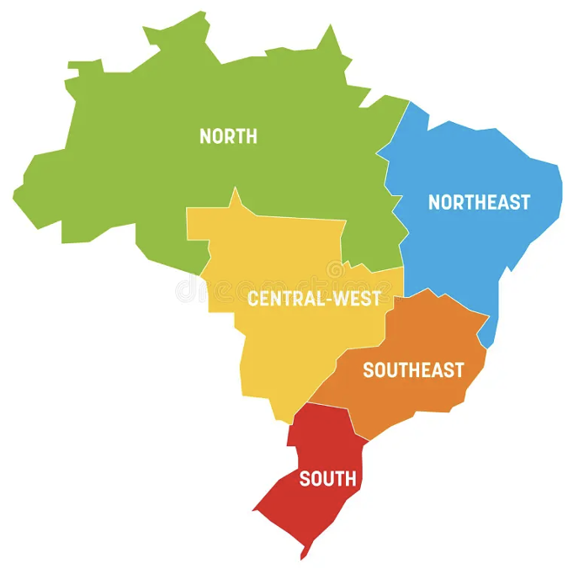
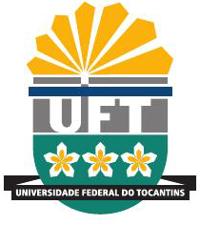





Network
CAPES Call for proposal13/2025

Slide 3
CAPES Global Program Objectives
To contribute to strengthening Brazil’s international leadership in the areas and themes of the projects;
To consolidating its position as a strategic partner in global initiatives, while promoting mutual cooperation, intercultural dialogue, and sustainable development.
To create an international platform for research, innovation, and training of highly qualified human resources.
The social impacts cover human resources training, youth capacitation in mining regions, generation of employment and income, strengthening of local productive arrangements, and less dependence on large mining companies.

Slide 4
CAPES Global Program
General Information
Duration: | 5 years
Start date: | June 1, 2026
Call for applications: | Second half of 2026
Implementation of benefits: | 2027 to 2031
Resources: | Academic missions abroad for the Graduate Programs involved (6 to 14 days) Capacity Building abroad for the Graduate Programs involved (15 or 30 days) Sandwich Doctorate abroad for the Graduate Programs involved International visiting professor in Brazil Sandwich Doctorate in Brazil Postdoctoral research in Brazil Young Talent Program in Brazil

Slide 5
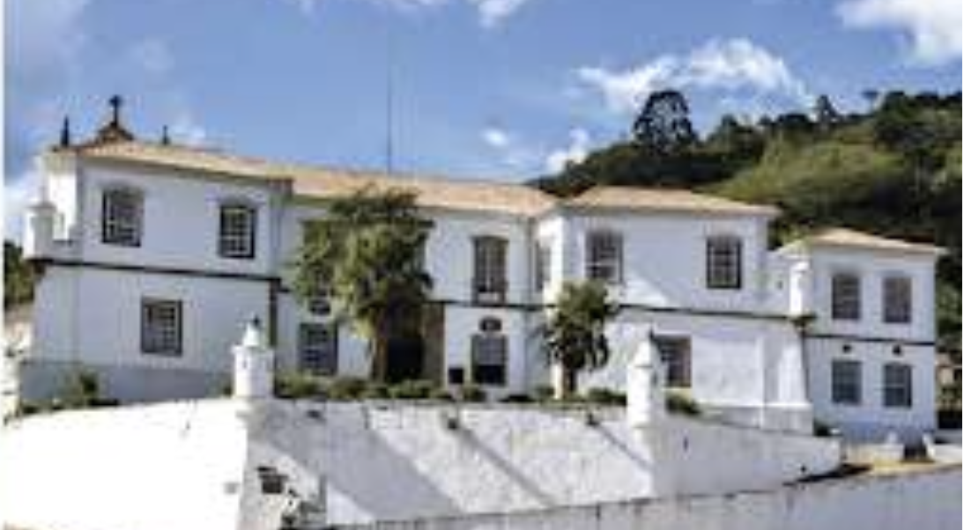

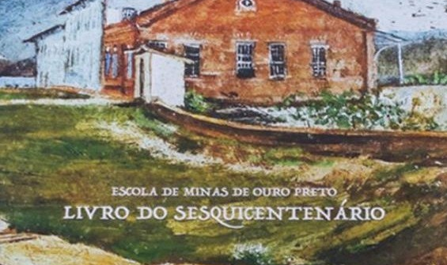
Theme 1 - Circular Mining: Geological exploration, sustainable mineral and metallurgical processing, smart production processes, uses and applications of materials, and utilization of waste and by-products

Slide 6
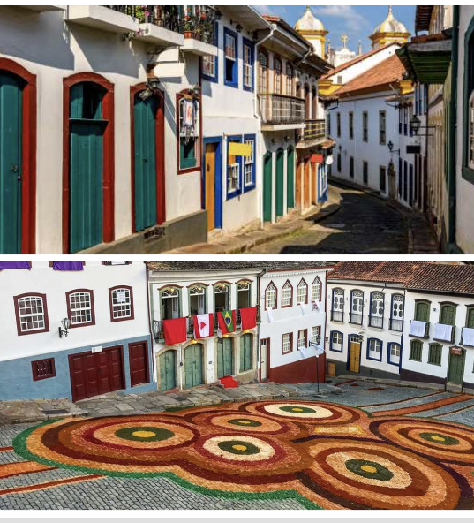
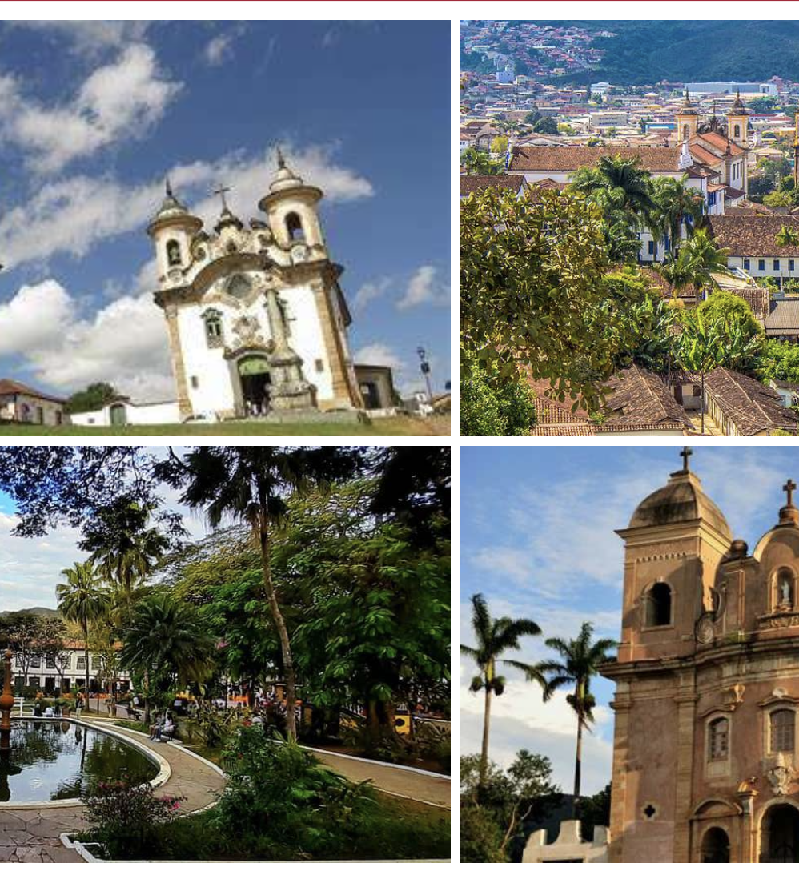

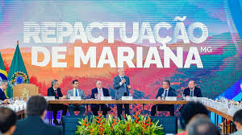
Theme 2 - Mining: Health, Society, and Education: contemporary challenges, sustainable strategies, and applications for the future

Slide 7
MineraMundi Project
Theme 1 - Circular Mining: Geological exploration, sustainable mineral and metallurgical processing, smart production processes, uses and applications of materials, and utilization of waste and by-products
Theme 2 - Mining: Health, Society, and Education: contemporary challenges, sustainable strategies, and applications for the future
The themes foster multidisciplinary articulation among different areas of knowledge, integration of the mineral chain, and analysis of impacts on health, education, environment, and communities.

Slide 8
Theme 1 - Circular Mining
Objectives:
To develop integrated research across the entire mining value chain, from exploration to waste management and socio-environmental impacts, through sustainable and intelligent solutions
To develop strategic international cooperation in research, management, and innovation in critical minerals essential to decarbonization, such as copper, nickel, graphite, cobalt, lithium, and rare earth elements

Slide 9
Theme 1 - Circular Mining
Objectives:
To strengthen socio-environmental governance and management in the mining sector by integrating research, capacity building, and international cooperation to support impact prevention, remediation, and mitigation
To foster the improvement of management models and environmental licensing in the mining sector, based on the principles of responsible production and consumption, and resilient infrastructure.

Slide 10
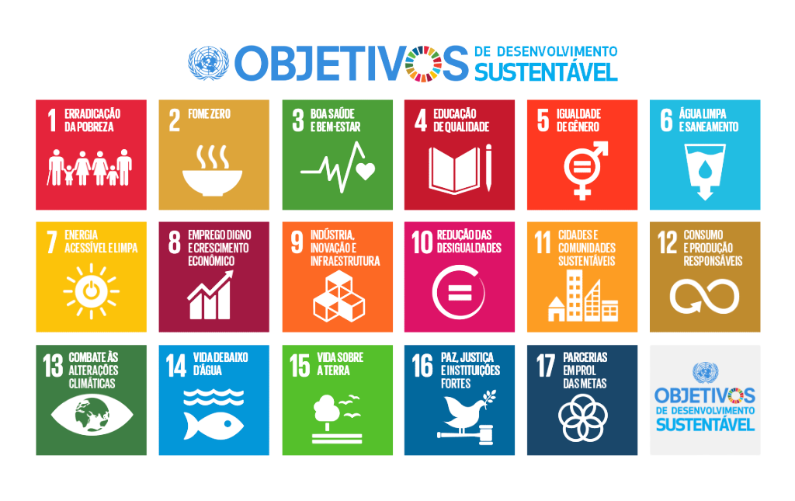
Theme 1
Alignment of Theme with Brazil's Priorities and SDGs:
Theme 1: Circular Mining
AI Plan for the Common Good
Science, Technology and Innovation Plan for Advanced Materials
National Circular Economy Plan
National Policy for Sustainable Territorial Development
National Mining Plan
SDGs 06, 08, 12 e 15.
Brazilian Mineral Policy
SDGs 06 - Clean Water and Sanitation
SDGs 08 - Decent Work and Economic Growth
SDGs 12 - Responsible Consumption and Production
SDGs 15 - Life on Land

Slide 11
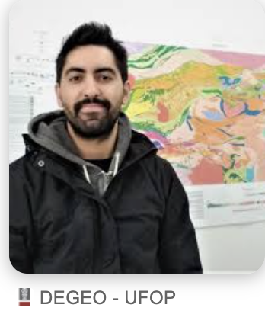
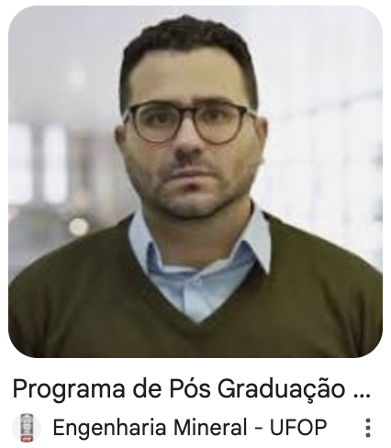
Theme 1: Strategic thematic coordinator
Professor Gustavo Melo (Crustal Evolution and natural resources)
gustavo.melo@ufop.edu.br
Professor Allan (Mineral Engineering)
allan.santos@ufop.edu.br

Slide 12
Theme 1: Graduate programs
Universidade Federal de Ouro Preto
Applied Economics
Materials Engineering
Civil Engineering
Environmental Engineering
Material Sciences
Pharmaceutical Sciences
Electrical Engineering
Production Engineering
Computer Science
Chemistry
Instrumentation, Control and Automation of Mining Processes
Crustal Evolution and natural resources
Mechanical Engineering
Biological Sciences
Health and Nutrition
Mineral Engineering
Geotechnics

Slide 13
Theme 1: Graduate programs
Universidade Federal de Campina Grande | Forest Sciences Chemical Engineering Mechanical Engineering Process Engineering Engineering and Management of natural resources
Universidade Federal do Oeste do Pará | Society, Nature and Development Natural resources of the Amazon Biosciences

Slide 14
Theme 1: Graduate programs
Universidade Federal do Tocantins | Biodiversity, Ecology and conservation Environmental Sciences Chemistry Geography

Slide 15
Theme 1: Graduate programs
Universidade Federal da Integração Latino-América | Civil Engineering
Universidade Federal do Rio Grande do Sul | Civil Engineering Microelectronics Agribusiness

Slide 16
Theme 2 - Mining: Health, Society, and Education
Objectives:
To develop research with international partners on the environmental, territorial, social, economic, cultural, educational, and health impacts of mining
To develop fair and equitable actions to prevent and reduce the environmental, territorial, social, economic, cultural, educational, and health impacts of mining and extractive activities

Slide 17
Theme 2 - Mining: Health, Society, and Education
Objectives:
To promote quality education in communities and Indigenous peoples affected by mining, integrating theoretical, social, ethnic, and cultural knowledge with the international academic community
To promote health through intercultural education, strengthening awareness and the appreciation of sustainable lifestyles in the context of mining activities.

Slide 18
Theme 2
Alignment of Theme with Brazil's Priorities and SDGs:
Theme 2: Mining: Health, Society, and Education
National Policy for Sustainable Territorial Development
National Policy for the Sustainable Development of Traditional Peoples and Communities
National Plan for Education in Human Rights
National Plan for Education
SDGs 03, 04, 10, 13 e 16
National Policy for Regional Development
SDGs 03 - Good health and well-being
SDGs 04 - Quality Education
SDGs 10 - Reduce inequalities
SDGs 13 - Climate action
SDGs 16 - Peace, justice and strong institutions

Slide 19
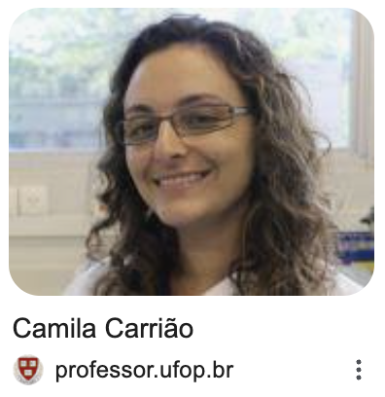
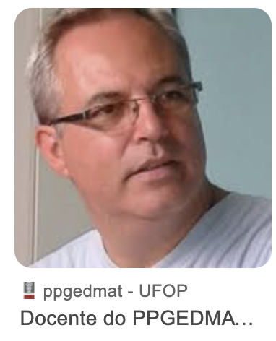
Theme 2: Strategic thematic coordinator
Professor Camila Carrião Machado Garcia (Graduate Program in Biological Sciences) carriao@ufop.edu.br
Professor Milton Rosa (Graduate Program in Mathematics Education)
milton.rosa@ufop.edu.br

Slide 20
Theme 2: Graduate programs
Universidade Federal de Ouro Preto | Biological Sciences Letters Mathematics Education Communication Law Philosophy Pharmaceutical Sciences Environmental Engineering Health and Nutrition

Slide 21
Theme 2: Graduate programs
Universidade Federal de Campina Grande | Language and Teaching Education History
Universidade Federal do Oeste do Pará | Society, Environment and Quality of Life Natural Resources of the Amazon Biosciences Society, Nature and Development

Slide 22
Theme 2: Graduate programs
Universidade Federal da Integração Latino-América | Comparative Literature Contemporary Integration of Latin America International Relations
Universidade Federal do Rio Grande do Sul | International Strategic Studies Civil Engineering

Slide 23
Theme 1: Graduate programs
Universidade Federal do Tocantins | Public Administration in National Network Education in the Amazon Education Teaching in Sciences and Health Physical Education in National Network Mathematics in National Network History of Amazonian Populations Communication and Society Environmental Sciences

Slide 24

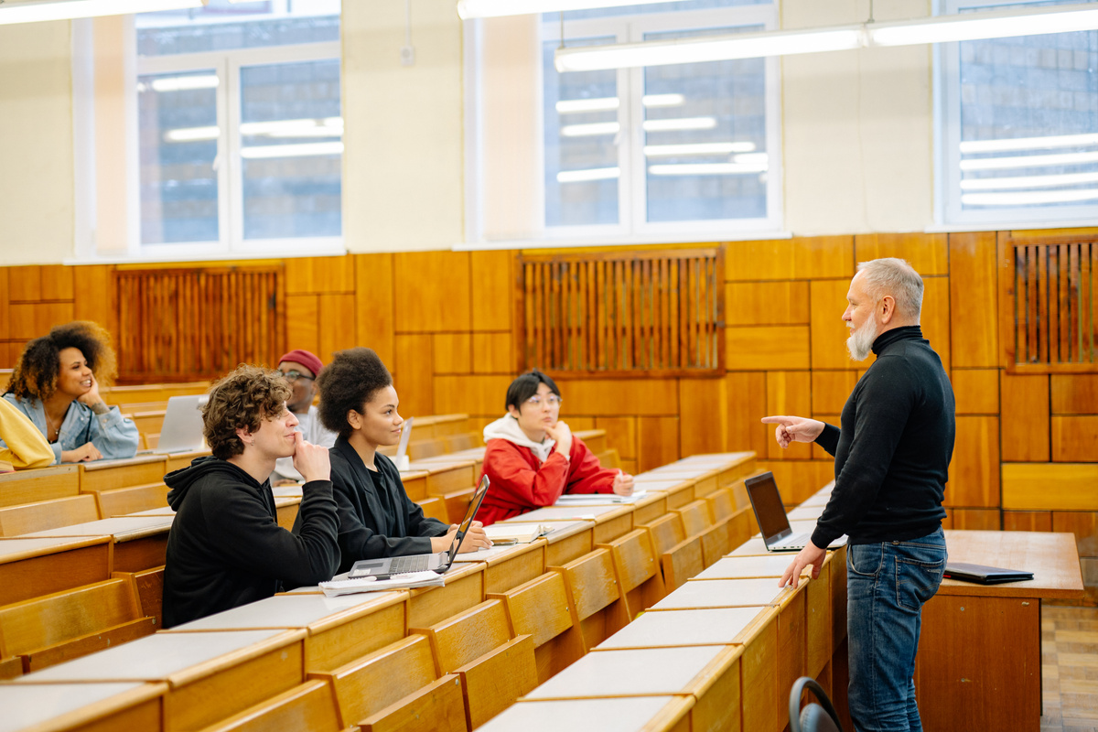



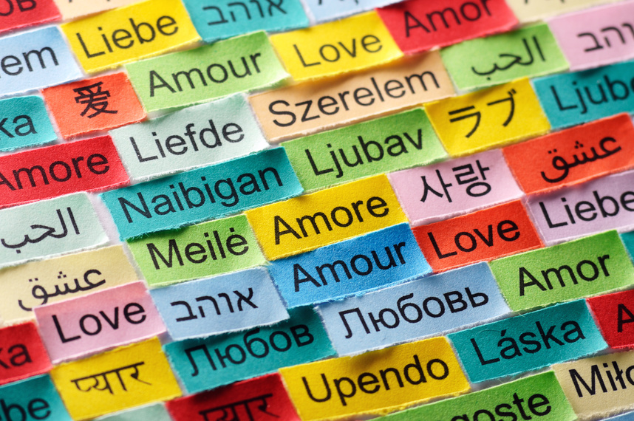
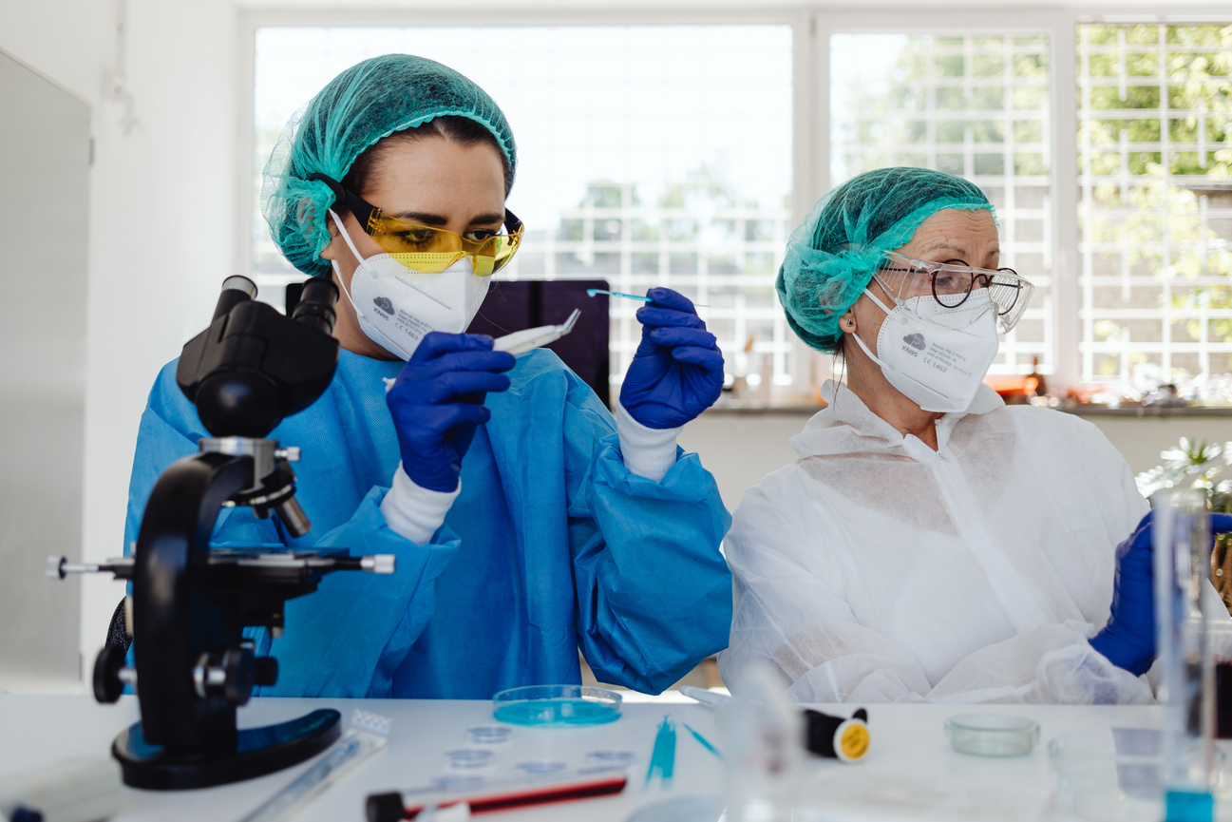

Goals of Minerandi
International Cooperation
Excellence Training
Academic Mobility
Integration of Graduate Programs
Strengthen partnerships with universities and global partners
Highly qualified human resources committed to society
Cotutelle agreements, dual degrees, and international exchanges
Connecting consolidated and emerging graduate programs
Strategic Knowledge
Multilingualism
Curriculum
Scientific Visibility
Continuous Excellence
High-impact collaborative scientific projects
Internationalization and linguistic diversity
International projection of the network’s universities
Strengthening and continuous development of graduate programs

Slide 25
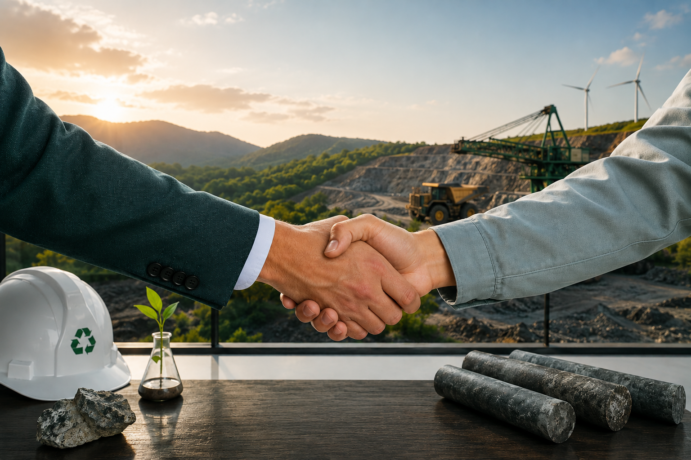
Collaboration in Mineramundi Network
Building together a sustainable future

Slide 26
MineraMundi: International research network on mining, sustainability and social development
Contact: capesglobal@ufop.edu.br

